Slide 1

Digital Integrated Circuits
A Design Perspective
Jan M. Rabaey
Anantha Chandrakasan
Borivoje Nikolic
Semiconductor
Memories
December 20, 2002

Slide 2
Chapter Overview
Memory Classification
Memory Architectures
The Memory Core
Periphery
Reliability
Case Studies

Slide 3
Semiconductor Memory Classification
Non-Volatile
Read-Write
Memory
Read-Write Memory
Read-Only Memory
Random
Non-Random
EPROM
Mask-Programmed
Access
Access
E
2
PROM
Programmable (PROM)
SRAM
FIFO
FLASH
DRAM
LIFO
Shift Register
CAM

Slide 4
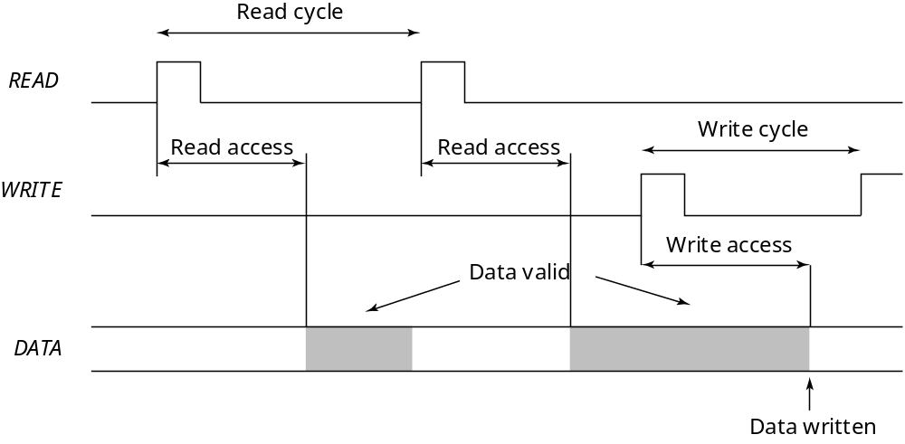
Memory Timing: Definitions

Slide 5
Memory Architecture: Decoders
M
bits
M
bits
S
0
S
0
Word 0
Word 0
S
1
Word 1
A
0
Word 1
S
2
Storage
Storage
Word 2
cell
A
1
Word 2
cell
words
A
N
S
K
2
1
Decoder
N
2
2
Word
N
2
2
Word
N
2
2
S
N
2
1
Word
N
2
1
Word
N
2
1
K
5
log
2
N
Input-Output
Input-Output
(
M
bits)
(
M
bits)
Intuitive architecture for N x M memory
Too many select signals:
N words == N select signals
Decoder reduces the number of select signals
K = log
2
N

Slide 6
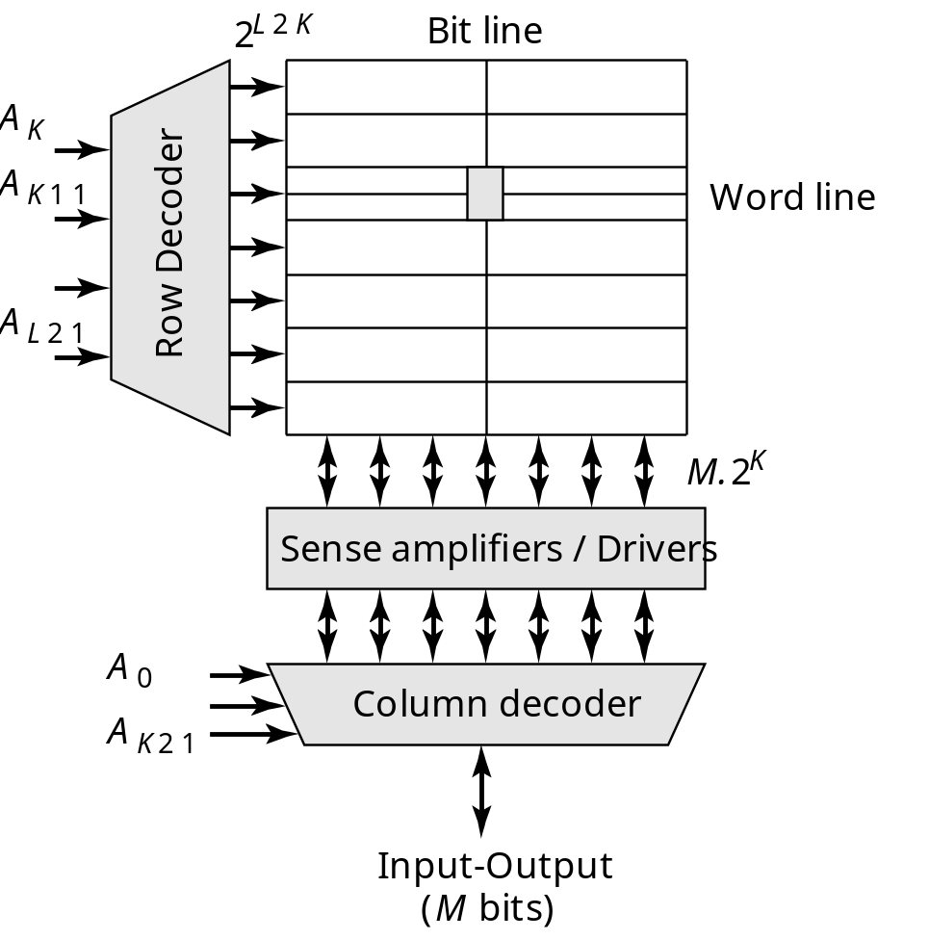
Array-Structured Memory Architecture
Problem: ASPECT RATIO or HEIGHT >> WIDTH
Amplify swing to
rail-to-rail amplitude
Selects appropriate
word

Slide 7
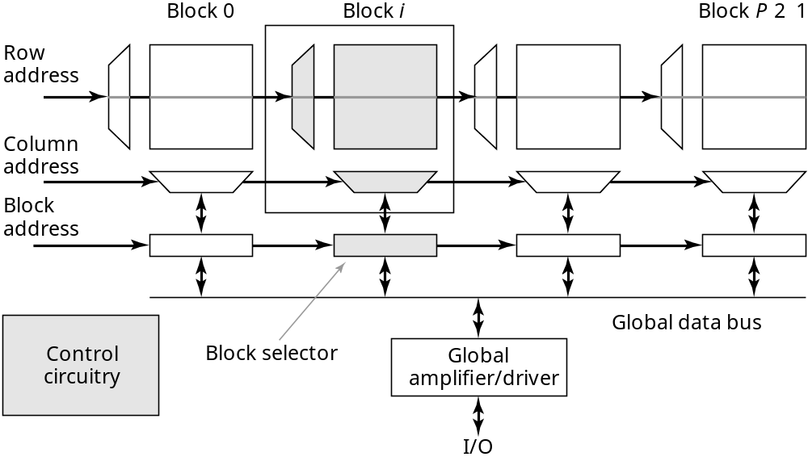
Hierarchical Memory Architecture
Advantages:
1. Shorter wires within blocks
2. Block address activates only 1 block => power savings

Slide 8
Block Diagram of 4 Mbit SRAM
Clock
Z
-address
X
-address
generator
buffer
buffer
Predecoder and block selector
Bit line load
128 K Array Block 0
Subglobal row decoder
Subglobal row decoder
Global row decoder
Block 30
Block 31
Block 1
Transfer gate
Column decoder
Sense amplifier and write driver
Local row decoder
CS, WE
I/O
x1/x4
Y
-address
X
-address
buffer
buffer
controller
buffer
buffer
[Hirose90]

Slide 9
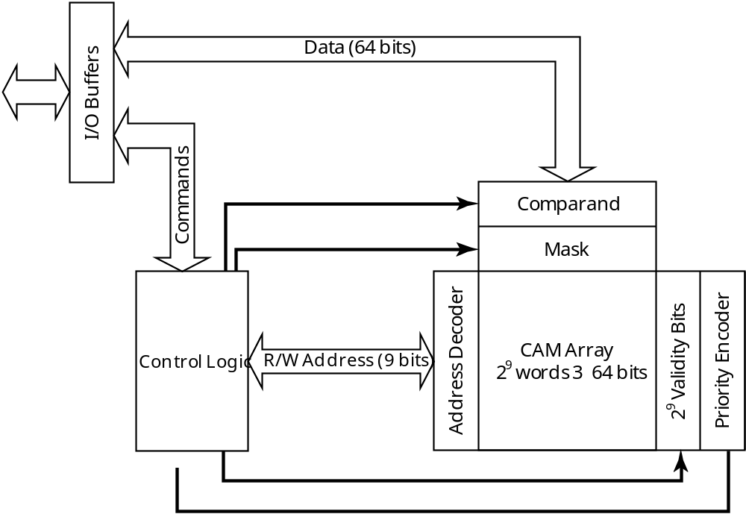
Contents-Addressable Memory
I/O Buffers
I/O Buffers
Commands
Commands
Validity Bits
9
2
Priority Encoder
Address Decoder
Validity Bits
9
2
Address Decoder
Priority Encoder

Slide 10
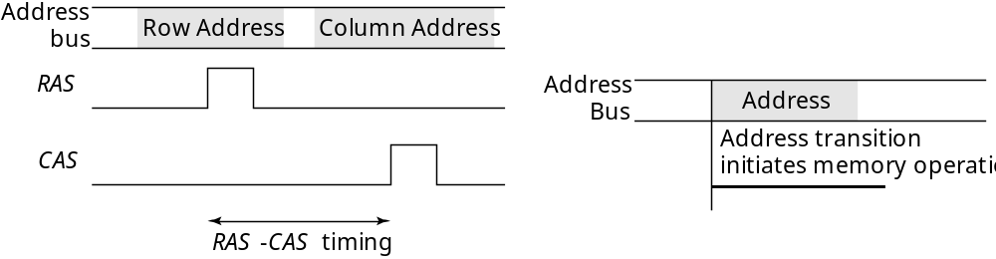
Memory Timing: Approaches
DRAM Timing
SRAM Timing
Multiplexed Adressing
Self-timed

Slide 11
Read-Only Memory Cells
BL
BL
BL
V_{DD}
WL
WL
WL
1
BL
BL
BL
WL
WL
WL
0
GND
Diode ROM
MOS ROM 1
MOS ROM 2

Slide 12
MOS OR ROM
BL
[0]
BL
[1]
BL
[2]
BL
[3]
WL
[0]
V
DD
WL
[1]
WL
[2]
V
DD
WL
[3]
V
bias
Pull-down loads

Slide 13
MOS NOR ROM
V
DD
Pull-up devices
WL
[0]
GND
WL
[1]
WL
[2]
GND
WL
[3]
BL
[0]
BL
[1]
BL
[2]
BL
[3]

Slide 14
MOS NOR ROM Layout
Cell (9.5λ x 7λ)
Programmming using the
Active Layer Only
Polysilicon
Metal1
Diffusion
Metal1 on Diffusion

Slide 15
MOS NOR ROM Layout
Cell (11λ x 7λ)
Programmming using
the Contact Layer Only
Polysilicon
Metal1
Diffusion
Metal1 on Diffusion

Slide 16
MOS NAND ROM
V
DD
Pull-up devices
BL
[0]
BL
[1]
BL
[2]
BL
[3]
WL
[0]
WL
[1]
WL
[2]
WL
[3]
All word lines high by default with exception of selected row

Slide 17
MOS NAND ROM Layout
Cell (8λ x 7λ)
Programmming using
the Metal-1 Layer Only
No contact to VDD or GND necessary;
drastically reduced cell size
Loss in performance compared to NOR ROM
Polysilicon
Diffusion
Metal1 on Diffusion

Slide 18
NAND ROM Layout
Cell (5λ x 6λ)
Programmming using
Implants Only
Polysilicon
Threshold-altering
implant
Metal1 on Diffusion

Slide 19
Equivalent Transient Model for MOS NOR ROM
Model for NOR ROM
V
DD
BL
WL
r
word
C
bit
c
word
Word line parasitics
  Wire capacitance and gate capacitance
  Wire resistance (polysilicon)
Bit line parasitics
  Resistance not dominant (metal)
  Drain and Gate-Drain capacitance

Slide 20
Equivalent Transient Model for MOS NAND ROM
V
DD
Model for NAND ROM
BL
r
C
L
bit
r
c
bit
WL
word
c
word
Word line parasitics
  Similar to NOR ROM
Bit line parasitics
  Resistance of cascaded transistors dominates
  Drain/Source and complete gate capacitance

Slide 21
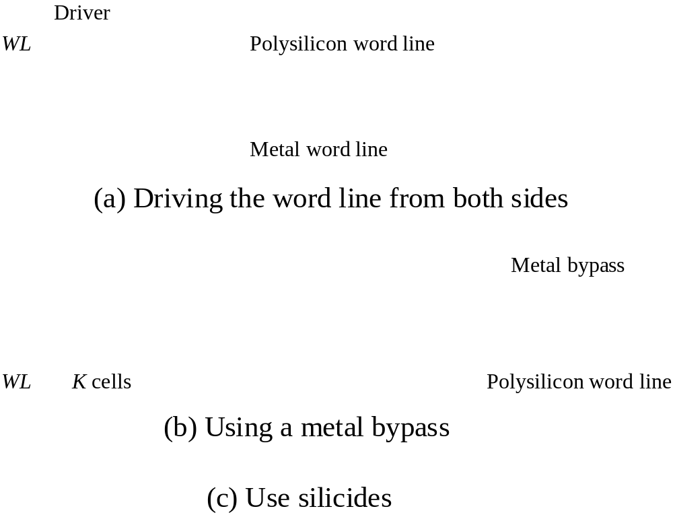
Decreasing Word Line Delay

Slide 22
Precharged MOS NOR ROM
f
pre
V
DD
Precharge devices
WL
[0]
GND
WL
[1]
WL
[2]
GND
WL
[3]
BL
[0]
BL
[1]
BL
[2]
BL
[3]
PMOS precharge device can be made as large as necessary,
but clock driver becomes harder to design.

Slide 23
Non-Volatile Memories
The Floating-gate transistor (FAMOS)
Floating gate
Gate
D
Source
Drain
t
ox
G
t
ox
+
+_
S
n
p
n
Substrate
Device cross-section
Schematic symbol

Slide 24
Floating-Gate Transistor Programming
20 V
0 V
5 V
10 V
5 V
20 V
2
5 V
0 V
2
2.5 V
5 V
S
D
S
D
S
D
Avalanche injection
Removing programming
voltage leaves charge trapped
Programming results in
higher
V
T
.

Slide 25
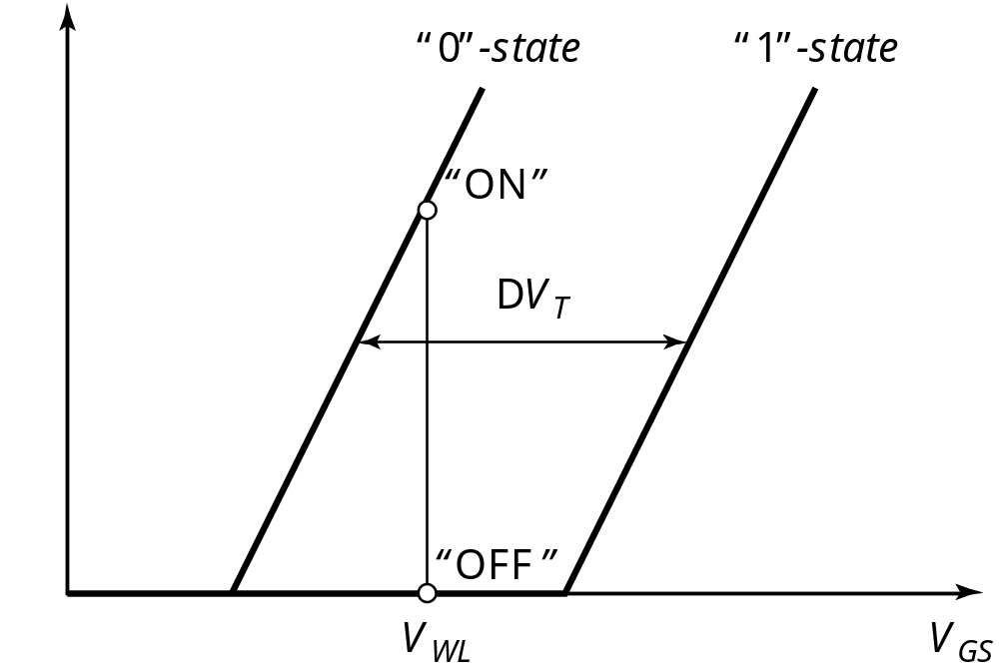
A “Programmable-Threshold” Transistor

Slide 26
FLOTOX EEPROM
Floating gate
Gate
I
Source
Drain
20
–
30 nm
-10 V
V
GD
10 V
n
1
Substrate
n
1
p
10 nm
Fowler-Nordheim
I-V characteristic
FLOTOX transistor

Slide 27
EEPROM Cell
BL
WL
Absolute threshold control
is hard
Unprogrammed transistor
might be depletion
⇨ 2 transistor cell
V
DD

Slide 28
Flash EEPROM
Control gate
Floating gate
erasure
Thin tunneling oxide
n
1
source
n
1
drain
programming
p-
substrate
Many other options …

Slide 29
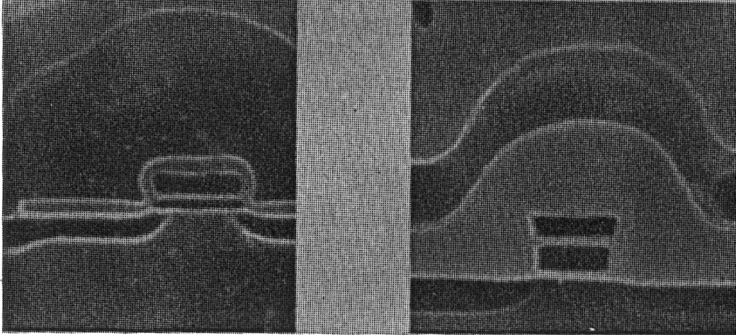
Cross-sections of NVM cells
Flash
EPROM
Courtesy Intel

Slide 30
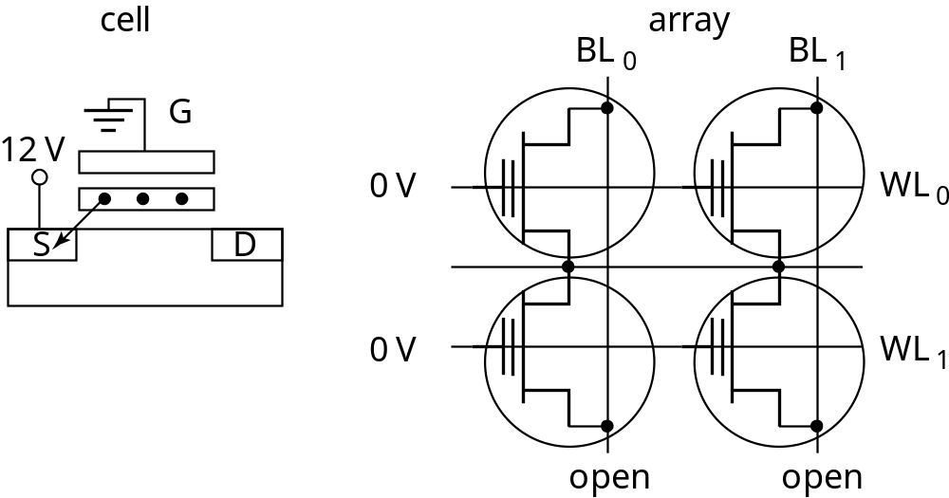
Basic Operations in a NOR Flash Memory―
Erase

Slide 31
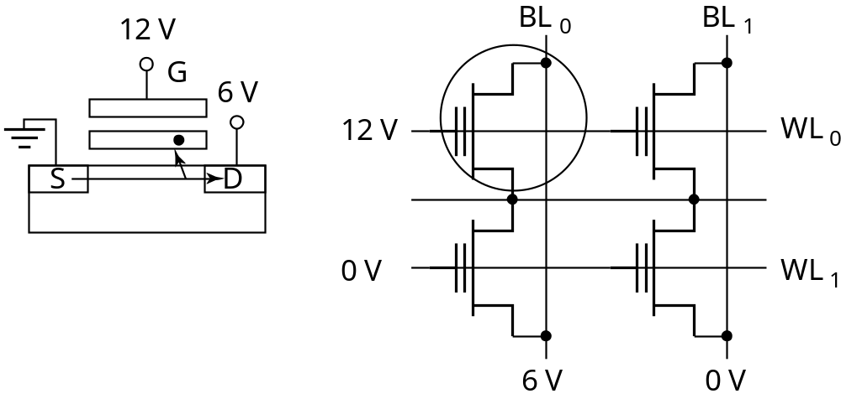
Basic Operations in a NOR Flash Memory―
Write

Slide 32
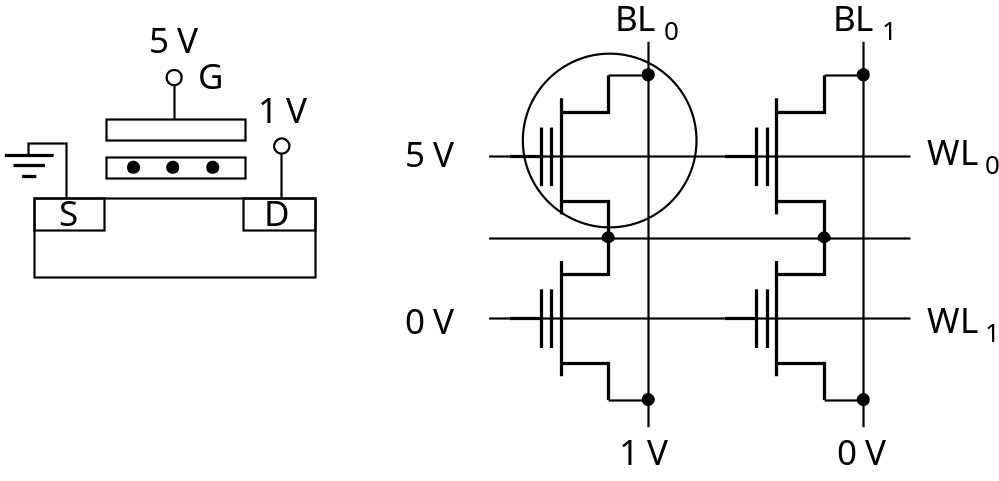
Basic Operations in a NOR Flash Memory―
Read

Slide 33
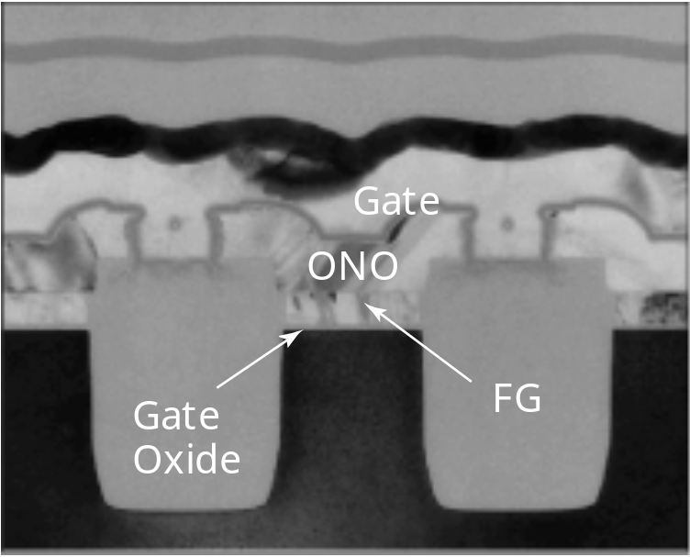
NAND Flash Memory
Word line(poly)
Unit Cell
Source line
(Diff. Layer)
Courtesy Toshiba

Slide 34
NAND Flash Memory
Select transistor
Word lines
Active area
STI
Bit line contact
Source line contact
Courtesy Toshiba

Slide 35
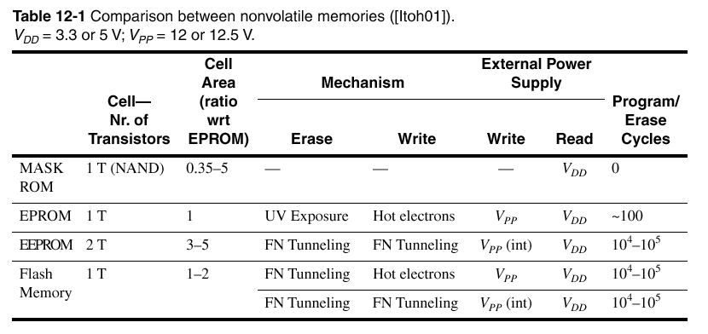
Characteristics of State-of-the-art NVM

Slide 36
Read-Write Memories (RAM)
STATIC (SRAM)
Data stored as long as supply is applied
Large (6 transistors/cell)
Fast
Differential
DYNAMIC (DRAM)
Periodic refresh required
Small (1-3 transistors/cell)
Slower
Single Ended

Slide 37
6-transistor CMOS SRAM Cell
WL
V
DD
M
2
M
4
Q
M
Q
M
6
5
M
1
M
3
BL
BL

Slide 38


CMOS SRAM Analysis (Read)
WL
V
DD
BL
M
4
BL
Q
=
0
Q
=
1
M
6
M
5
V
DD
M
1
V
DD
V
DD
C
bit
C
bit

Slide 39

CMOS SRAM Analysis (Read)
1.2
1
0.8
0.6
Voltage Rise (V)
0.4
0.2
Voltage rise [V]
0
0
0.5
1
1.2
1.5
2
2.5
3
Cell Ratio (CR)

Slide 40


CMOS SRAM Analysis (Write)
WL
V
DD
M
4
Q
=
0
M
6
M
5
Q
=
1
M
1
V
DD
BL
=
1
BL
=
0

Slide 41
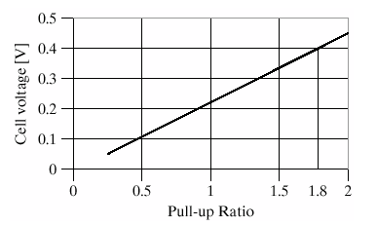
CMOS SRAM Analysis (Write)

Slide 42

6T-SRAM — Layout
V_{DD}
M2
M4
Q
Q
M1
M3
GND
M5
M6
WL
BL
BL

Slide 43
Resistance-load SRAM Cell
WL
V
DD
R
L
R
L
Q
Q
M
3
M
4
BL
M
M
BL
1
2
Static power dissipation -- Want R
L
large
Bit lines precharged to V
DD
to address t
p
problem

Slide 44
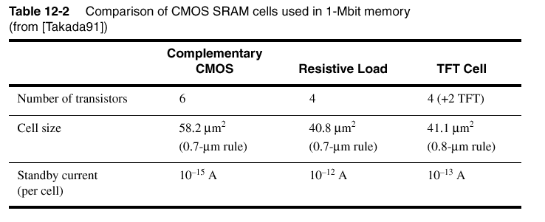
SRAM Characteristics

Slide 45
3-Transistor DRAM Cell
BL
1
BL
2
WWL
RWL
WWL
M
3
RWL
M
1
X
M
X
V
DD
2
V
T
2
BL
1
V
DD
C
S
BL
2
V
2
V
D
V
DD
T
No constraints on device ratios
Reads are non-destructive
Value stored at node X when writing a “1” = V
WWL
-V
Tn

Slide 46

3T-DRAM — Layout
BL2
BL1
GND
RWL
M3
M2
WWL
M1

Slide 47
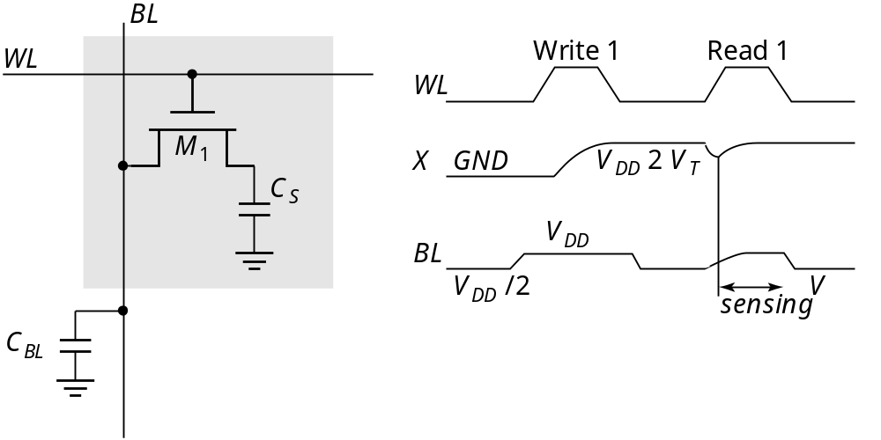
1-Transistor DRAM Cell
Write: C
S
is charged or discharged by asserting WL and BL.
Read: Charge redistribution takes places between bit line and storage capacitance
C
S
Δ
V
=
V
BL
–
V
PRE
=
V
BIT
–
V
PRE
------------
C
S
+
C
BL
Voltage swing is small; typically around 250 mV.

Slide 48
DRAM Cell Observations
1T DRAM requires a sense amplifier for each bit line, due to charge redistribution read-out.
DRAM memory cells are single ended in contrast to SRAM cells.
The read-out of the 1T DRAM cell is destructive; read and refresh operations are necessary for correct operation.
Unlike 3T cell, 1T cell requires presence of an extra capacitance that must be explicitly included in the design.
When writing a “1” into a DRAM cell, a threshold voltage is lost. This charge loss can be circumvented by bootstrapping the word lines to a higher value than V_{DD}

Slide 49
Sense Amp Operation
V
V
(1)
BL
V
PRE
D
V
(1)
V
(0)
Sense amp activated
t
Word line activated

Slide 50
1-T DRAM Cell
Capacitor
M
1
word
Metal word line
line
SiO
2
Poly
n
+
n
+
Field Oxide
Diffused
bit line
Poly
Inversion layer
induced by
Polysilicon
Polysilicon
plate bias
gate
plate
Cross-section
Layout
Uses Polysilicon-Diffusion Capacitance
Expensive in Area

Slide 51
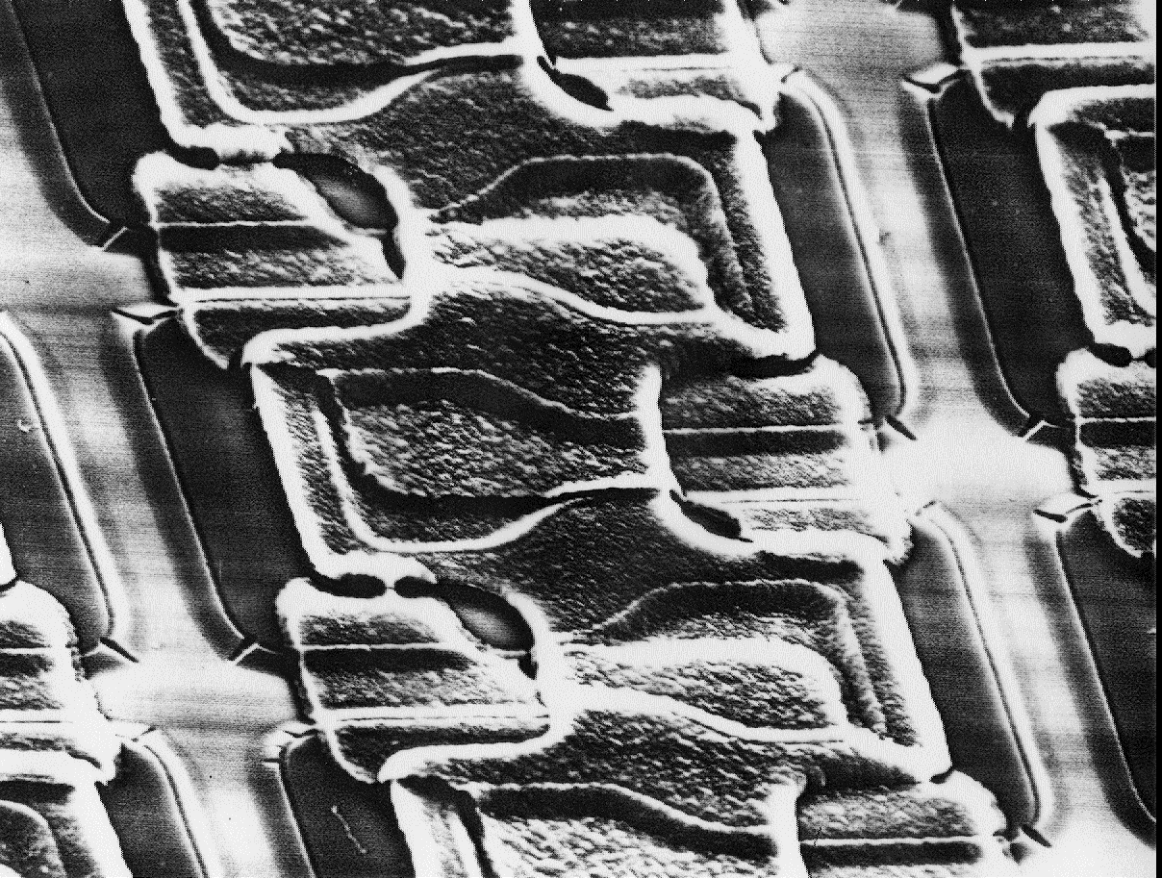
SEM of poly-diffusion capacitor 1T-DRAM

Slide 52
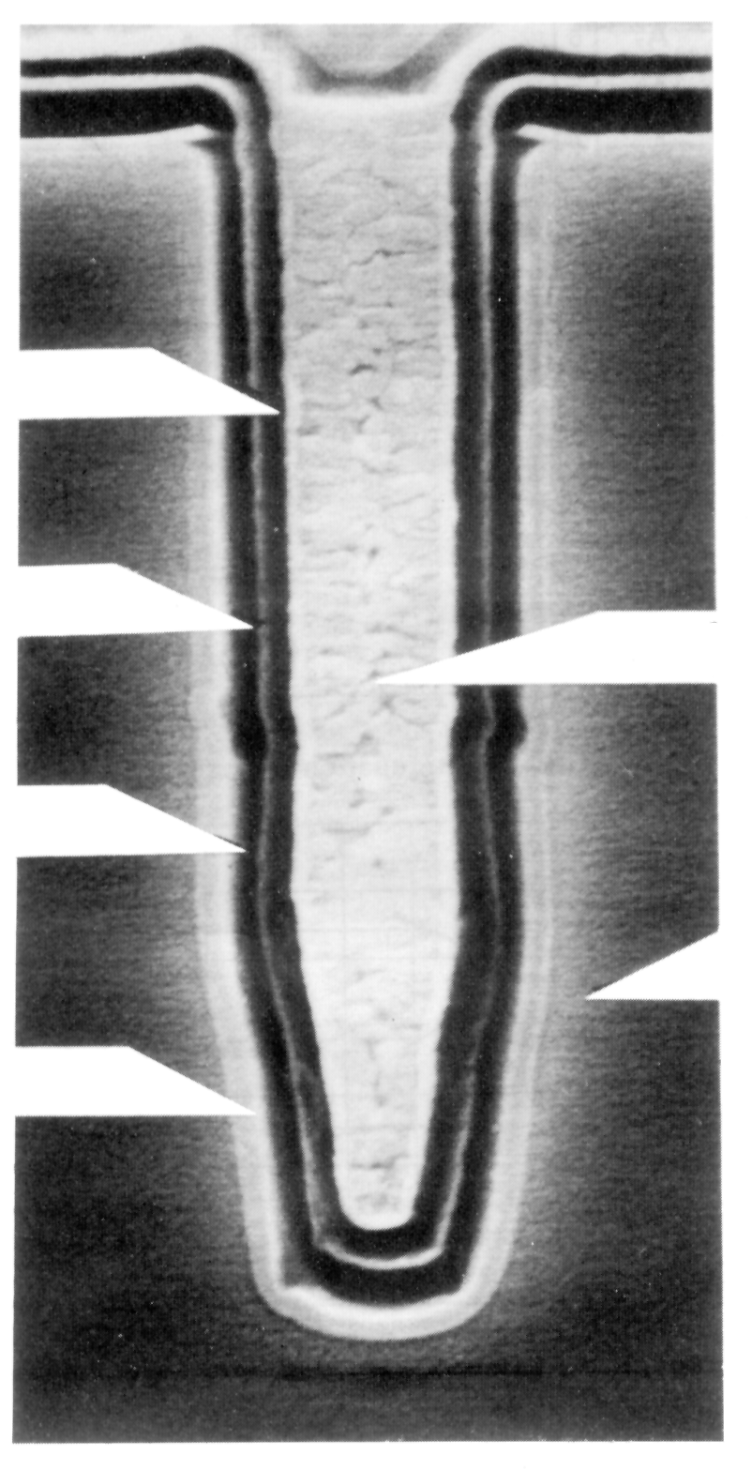
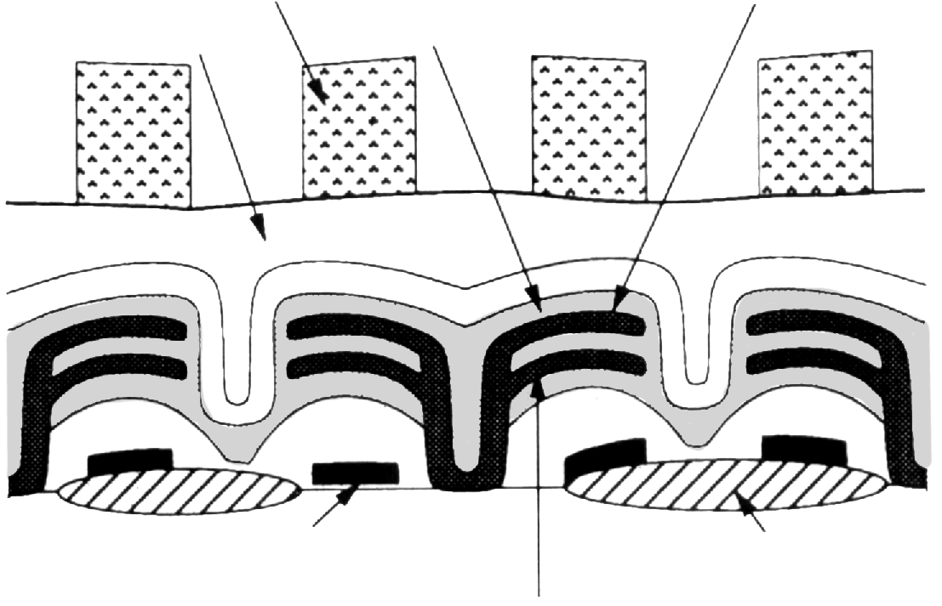
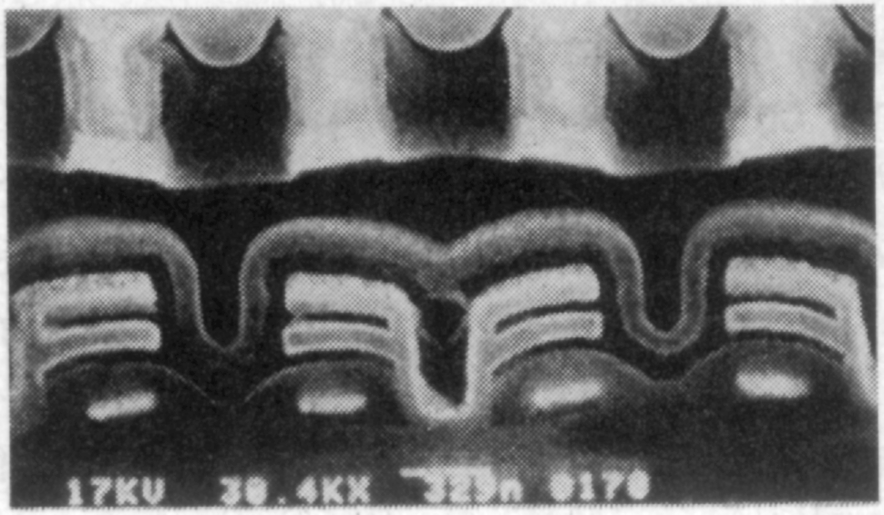
Advanced 1T DRAM Cells
Word line
Cell plate
Capacitor dielectric layer
Insulating Layer
Cell Plate Si
Refilling Poly
Transfer gate
Isolation
Capacitor Insulator
Storage electrode
Storage Node Poly
Si Substrate
2nd Field Oxide
Trench Cell
Stacked-capacitor Cell

Slide 53
Static CAM Memory Cell
Bit
Bit
Bit
Bit
Word
Bit
Bit
M8
M9
M4
M5
CAM
•••
CAM
M6
M7
Word
•••
•••
Word
S
S
int
CAM
•••
CAM
M3
M2
Match
M1
Wired-NOR Match Line

Slide 54
CAM in Cache Memory
CAM
SRAM
ARRAY
ARRAY
Hit Logic
Address Decoder
Input Drivers
Sense Amps / Input Drivers
Address
Tag
Hit
R/W
Data

Slide 55
Periphery
Decoders
Sense Amplifiers
Input/Output Buffers
Control / Timing Circuitry

Slide 56
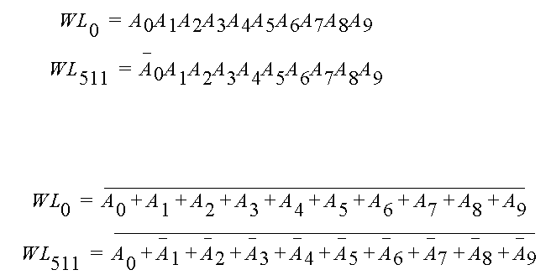
Row Decoders
Collection of 2^{M} complex logic gates
Organized in regular and dense fashion
(N)AND Decoder
NOR Decoder

Slide 57
Hierarchical Decoders
Multi-stage implementation improves performance
•
•
•
WL
1
WL
0
A
0
A
1
A
0
A
1
A
0
A
1
A
0
A
1
A
2
A
3
A
2
A
3
A
2
A
3
A
2
A
3
•
•
•
NAND decoder using
2-input pre-decoders
A
1
A
0
A
0
A
1
A
3
A
2
A
2
A
3

Slide 58
Dynamic Decoders
Precharge devices
GND
GND
V
DD
V
WL
3
WL
3
DD
WL
V
WL
2
2
DD
WL
1
WL
V
DD
1
WL
0
WL
0
V
DD
φ
A
0
A
0
A
1
A
1
A
A
A
A
φ
0
0
1
1
2-input NOR decoder
2-input NAND decoder

Slide 59
4-input pass-transistor based column decoder
BL
0
BL
1
BL
2
BL
3
S
0
A
0
S
1
S
2
A
1
S
3
2-input NOR decoder
D
Advantages: speed (t_{pd} does not add to overall memory access time)
Only one extra transistor in signal path
Disadvantage: Large transistor count

Slide 60
4-to-1 tree based column decoder
BL
0
BL
1
BL
2
BL
3
A
0
A
0
A
1
A
1
D
Number of devices drastically reduced
Delay increases quadratically with # of sections; prohibitive for large decoders
Solutions:
buffers
progressive sizing
combination of tree and pass transistor approaches

Slide 61
Decoder for circular shift-register
V
DD
V
DD
V
DD
V
DD
V
DD
V
DD
WL
0
WL
1
WL
2
f
f
f
f
f
f
•
•
•
R
f
f
R
f
f
R
f
f
V
DD

Slide 62
Sense Amplifiers
make
Δ
V as small
C
⋅
Δ
V
as possible
t
p
=
----------------
I
av
large
small
Idea: Use Sense Amplifer
small
transition
s.a.
input
output

Slide 63
Differential Sense Amplifier
V
DD
M
3
M
4
y
Out
bit
M
1
M
2
bit
SE
M
5
Directly applicable to
SRAMs

Slide 64
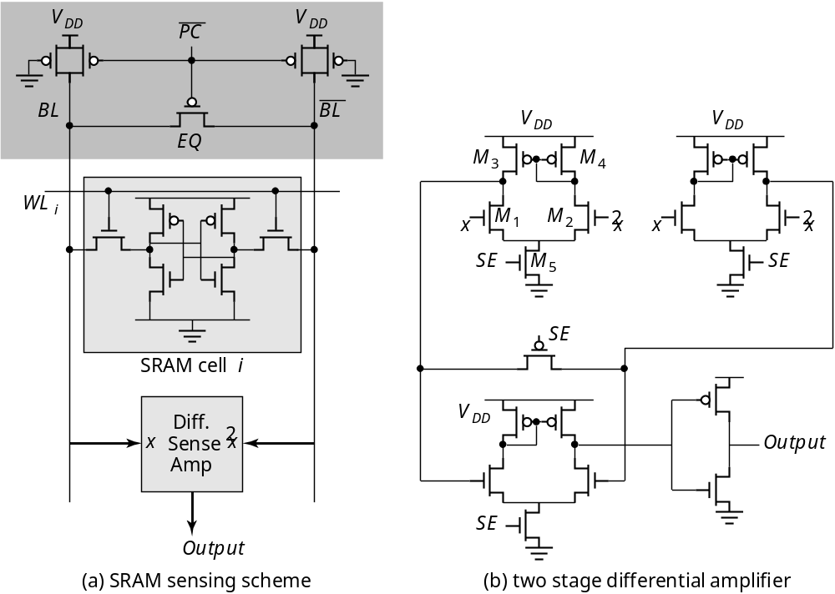
Differential Sensing ― SRAM

Slide 65
Latch-Based Sense Amplifier (DRAM)
EQ
BL
BL
V
DD
SE
SE
Initialized in its meta-stable point with EQ
Once adequate voltage gap created, sense amp enabled with SE
Positive feedback quickly forces output to a stable operating point.

Slide 66
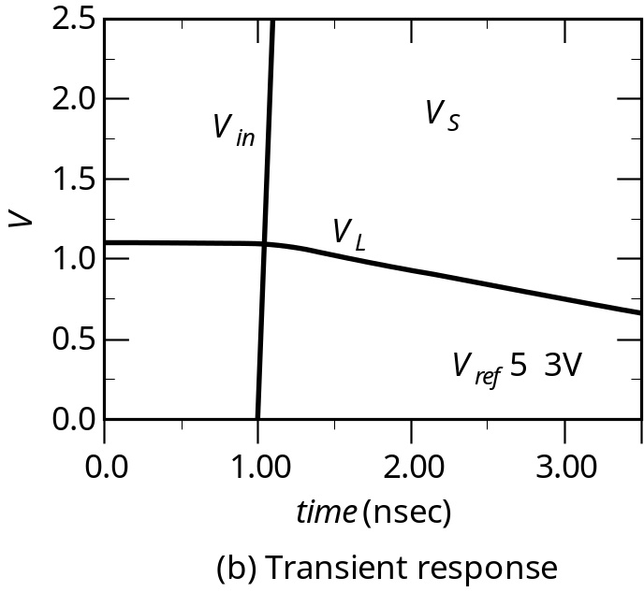
Charge-Redistribution Amplifier
V
ref
V
L
M
V
S
1
C
small
M
M
C
large
2
3
Transient Response
Concept

Slide 67
Charge-Redistribution Amplifier―
EPROM
V
DD
SE
M
Load
4
Out
C
Cascode
V
M
out
device
casc
3
C
col
Column
WLC
M
decoder
2
BL
M
C
BL
EPROM
WL
1
array

Slide 68
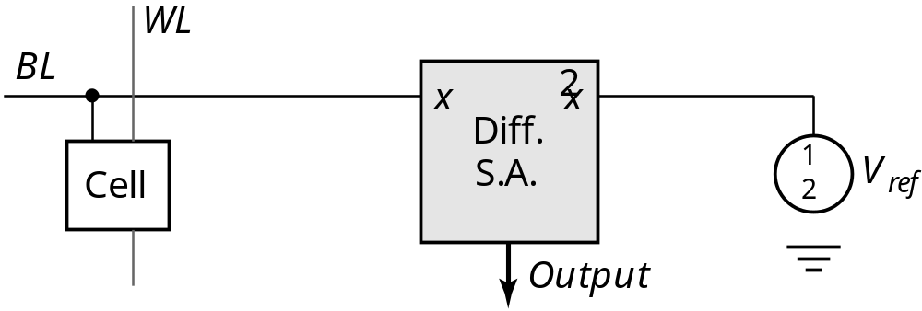
Single-to-Differential Conversion
How to make a good V_{ref}?

Slide 69
Open bitline architecture with dummy cells
EQ
L
L
1
L
0
V
DD
R
R
L
0
1
SE
BLL
BLR
…
…
C
S
C
S
C
S
SE
C
C
C
S
S
S
Dummy cell
Dummy cell

Slide 70
DRAM Read Process with Dummy Cell
3
3
2
2
BL
BL
V
V
1
BL
1
BL
0
0
1
2
3
0
0
1
2
3
t
(ns)
t
(ns)
reading 0
reading 1
3
EQ
WL
2
V
SE
1
0
0
1
2
3
t
(ns)
control signals

Slide 71
Voltage Regulator
V
DD
M
drive
V
REF
V
DL
Equivalent Model
V
bias
V
REF
-
M
drive
+
V
DL

Slide 72
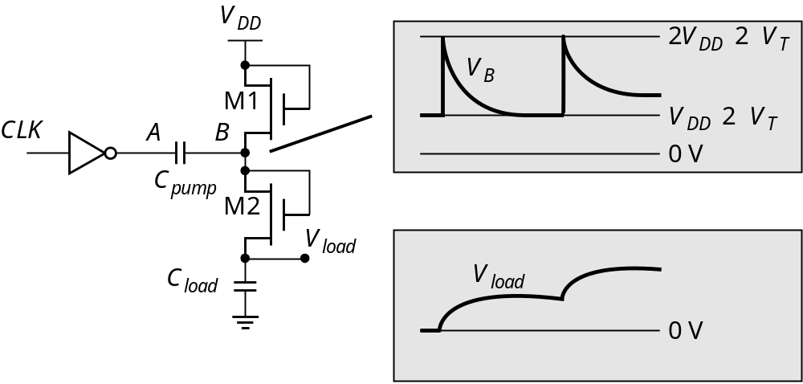
Charge Pump

Slide 73
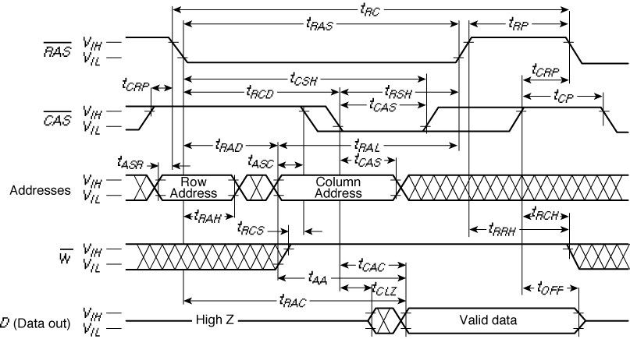
DRAM Timing

Slide 74
RDRAM Architecture
Bus
Clocks
k
Data
k
3
l
memory
bus
array
network
mux/demux
Column
demux
packet dec.
Row
demux
packet dec.

Slide 75
Address Transition Detection
V
DD
DELAY
A
0
t
d
ATD
ATD
DELAY
A
1
t
d
DELAY
…
A
N
1
t
d
2

Slide 76
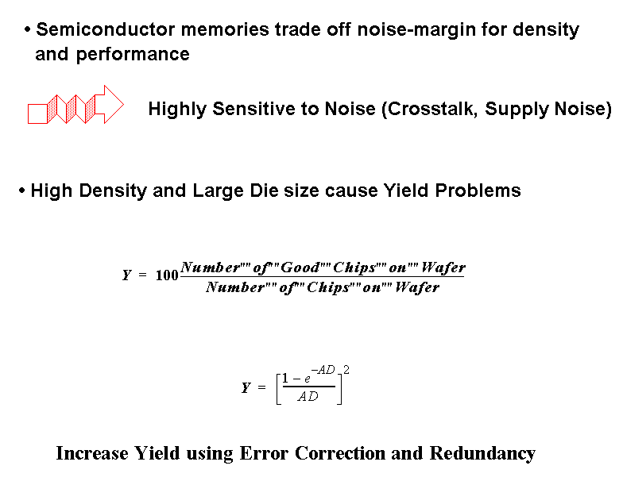
Reliability and Yield

Slide 77
Sensing Parameters in DRAM
1000
C
D
(1F)
V
smax
(mv)
100
Q
S
(1C)
smax
C
S
(1F)
V
,
DD
V
,
S
C
10
,
S
Q
V
,
DD
(V)
D
Q
C
V
/
2
C
S
5
S
DD
V
smax
5
Q
S
/
(
C
S
1
C
D
)
4K
64K
1M
16M
256M
4G
64G
Memory Capacity (bits
/
chip)
From [Itoh01]

Slide 78
Noise Sources in 1T DRam
BL
substrate
Adjacent BL
C
WBL
a
-particles
WL
leakage
C
S
electrode
C
cross

Slide 79
Open Bit-line Architecture —Cross Coupling
EQ
WL
1
WL
0
C
WL
D
C
WL
D
WL
0
WL
1
WBL
WBL
BL
BL
C
BL
Sense
C
BL
C
C
C
Amplifier
C
C
C

Slide 80
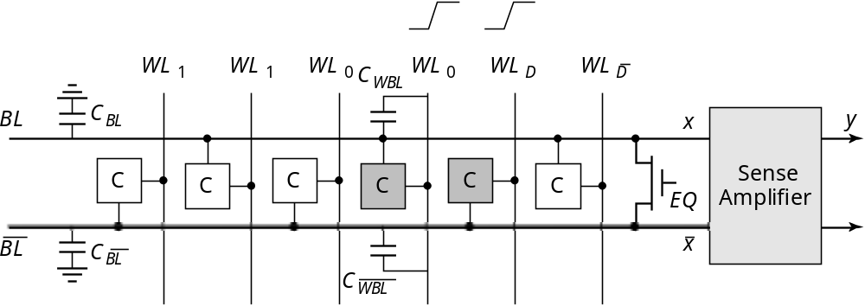
Folded-Bitline Architecture

Slide 81
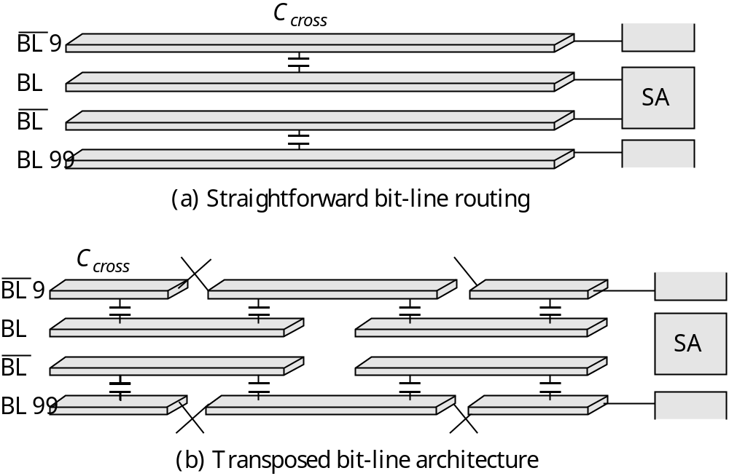
Transposed-Bitline Architecture

Slide 82
Alpha-particles (or Neutrons)
a
-particle
WL
V
DD
BL
SiO
n
1
2
2
1
1
2
2
1
2
1
2
1
2
1
1 Particle ~ 1 Million Carriers

Slide 83
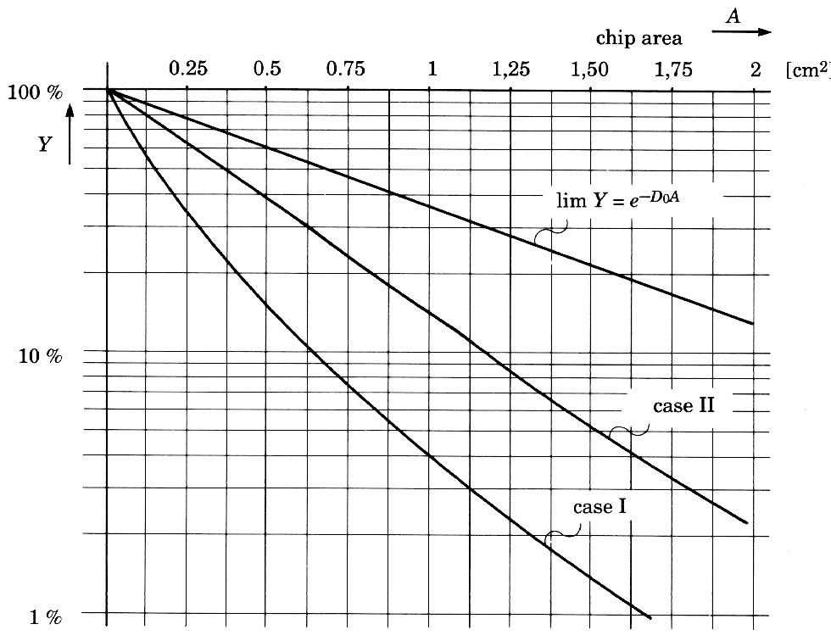
Yield
Yield curves at different stages of process maturity
(from [Veendrick92])

Slide 84
Redundancy
Row
Redundant
Address
rows
:
Fuse
Bank
Redundant
columns
Memory
Array
Row Decoder
Column Decoder
Column
Address

Slide 85
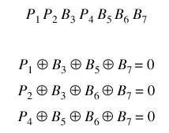
Error-Correcting Codes
Example: Hamming Codes
e.g. B3 Wrong
with
1
1
= 3
0

Slide 86
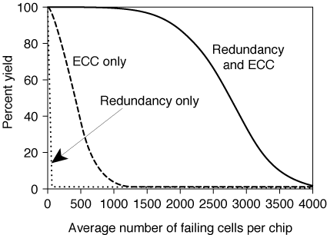
Redundancy and Error Correction

Slide 87
Sources of Power Dissipation in Memories
V
DD
CHIP
I
DD
5
S
C
i
D
V
i
f
1S
I
DCP
nC
DE
V
INT
f
m
C
V
f
selected
mi
act
PT
INT
I
DCP
n
ROW
non-selected
m(n
2
1)i
hld
DEC
ARRAY
mC
DE
V
INT
f
PERIPHERY
COLUMN DEC
V
SS
From [Itoh00]

Slide 88
Data Retention in SRAM
1.30u
1.10u
0.13 m CMOS
m
900n
700n
I_{leakage}
500n
Factor 7
(A)
300n
0.18 m CMOS
m
100n
0.00
.600
1.20
1.80
V_{DD}
SRAM leakage increases with technology scaling

Slide 89
Suppressing Leakage in SRAM
V
DD
low-threshold transistor
V
DD
V
DDL
sleep
V
DD,int
sleep
V
DD,int
SRAM
SRAM
SRAM
cell
cell
cell
SRAM
SRAM
SRAM
cell
cell
cell
V
SS,int
sleep
Inserting Extra Resistance
Reducing the supply voltage

Slide 90
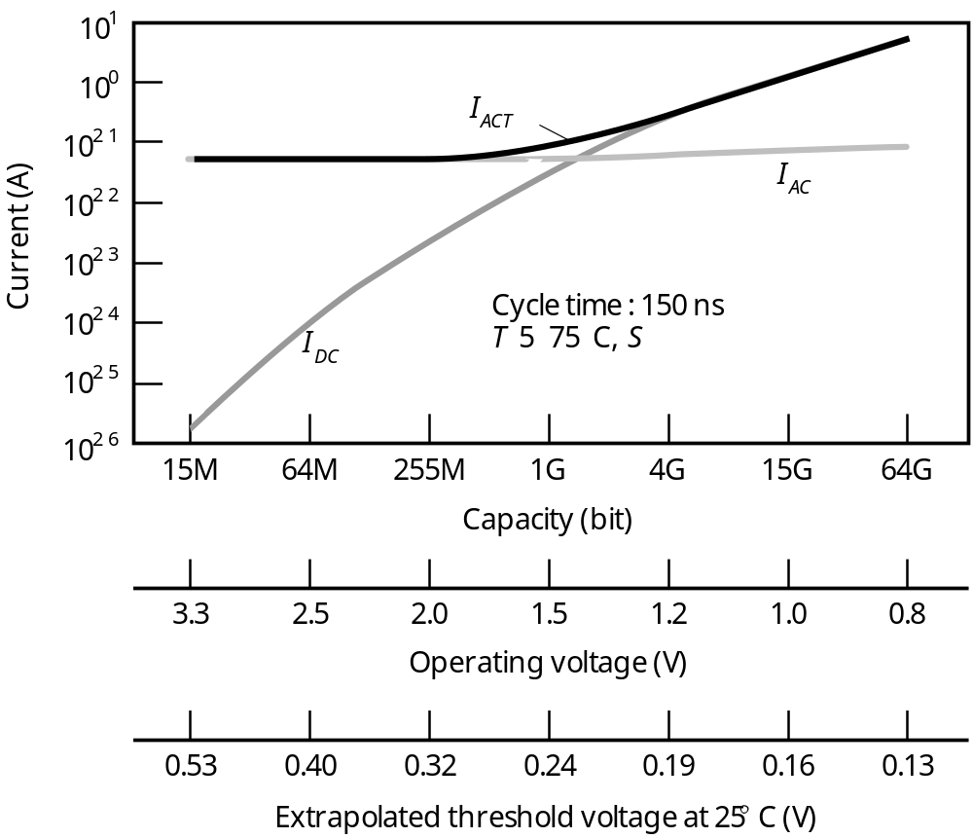
Data Retention in DRAM
From [Itoh00]

Slide 91
Case Studies
Programmable Logic Array
SRAM
Flash Memory

Slide 92
PLA versus ROM
Programmable Logic Array
structured approach to random logic
“two level logic implementation”
NOR-NOR (product of sums)
NAND-NAND (sum of products)
IDENTICAL TO ROM!
Main difference
ROM: fully populated
PLA: one element per minterm
Note: Importance of PLA’s has drastically reduced
1.
slow
2.
better software techniques (mutli-level logic
synthesis)
But …

Slide 93
Programmable Logic Array
Pseudo-NMOS PLA
V
DD
GND
GND
GND
GND
GND
GND
GND
V
DD
X
0
X
0
X
1
X
1
X
2
X
2
f
0
f
1
AND-plane
OR-plane

Slide 94
Dynamic PLA
f
AND
GND
V
DD
f
OR
f
OR
f
AND
V
DD
X
0
X
0
X
1
X
1
X
2
X
2
f
0
f
1
GND
AND-plane
OR-plane

Slide 95
Clock Signal Generation for self-timed dynamic PLA
f
f
Dummy AND row
f
AND
f
AND
t
pre
t
eval
f
AND
Dummy AND row
f
OR
f
OR
(a) Clock signals
(b) Timing generation circuitry

Slide 96

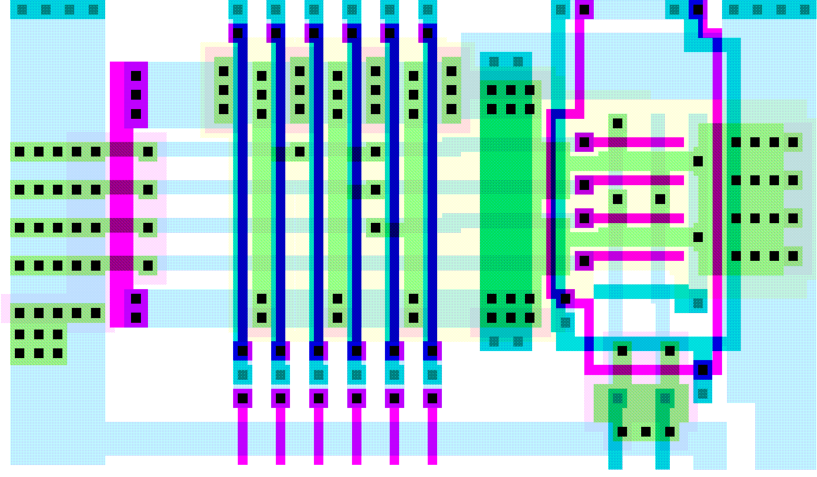
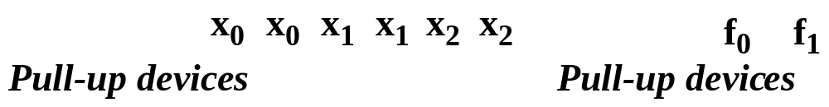
PLA Layout

Slide 97
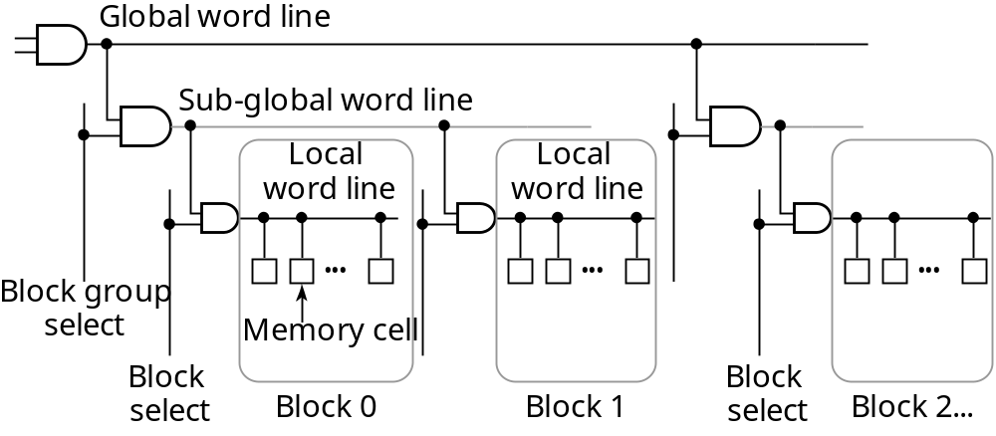
4 Mbit SRAM
Hierarchical Word-line Architecture

Slide 98
Bit-line Circuitry
Block
Bit-line
select
ATD
load
BEQ
Local
WL
Memory cell
B
/
T
B
/
T
CD
CD
CD
I
/
O
I/O line
I
/
O
Sense amplifier

Slide 99
Sense Amplifier (and Waveforms)
Address
I
/
O
I
/
O
ATD
SEQ
Block
select
ATD
BS
BEQ
Vdd
SA
BS
SA
I/O Lines
SEQ
GND
SEQ
SEQ
SEQ
SEQ
Vdd
DATA
SA, SA
De
i
GND
DATA
BS
Data-cut

Slide 100
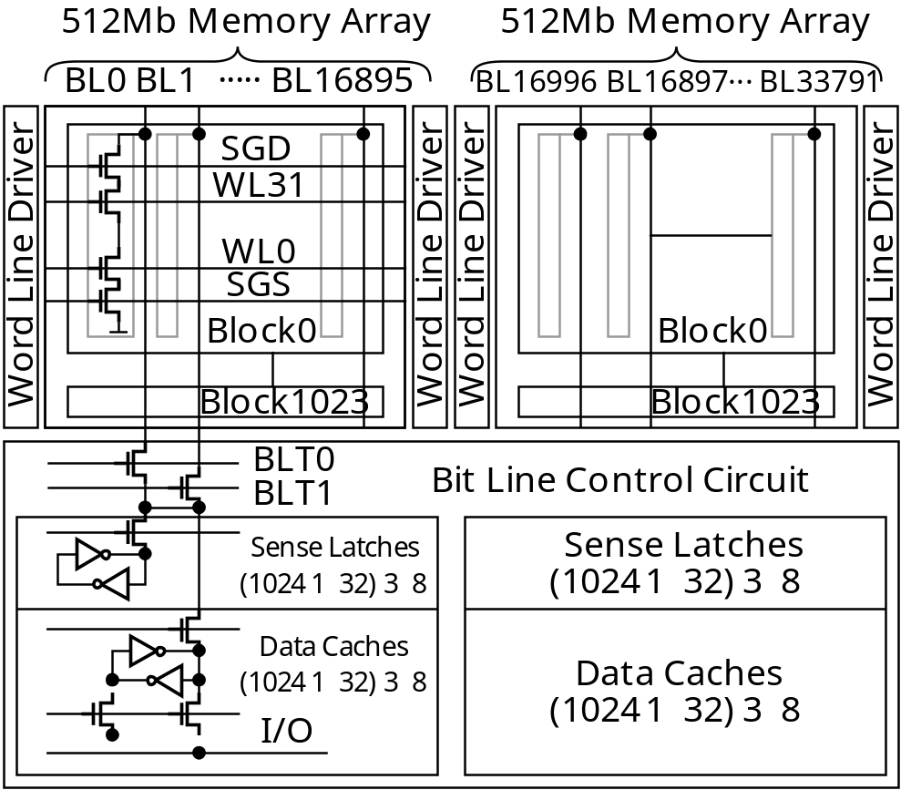
1 Gbit Flash Memory
From [Nakamura02]

Slide 101
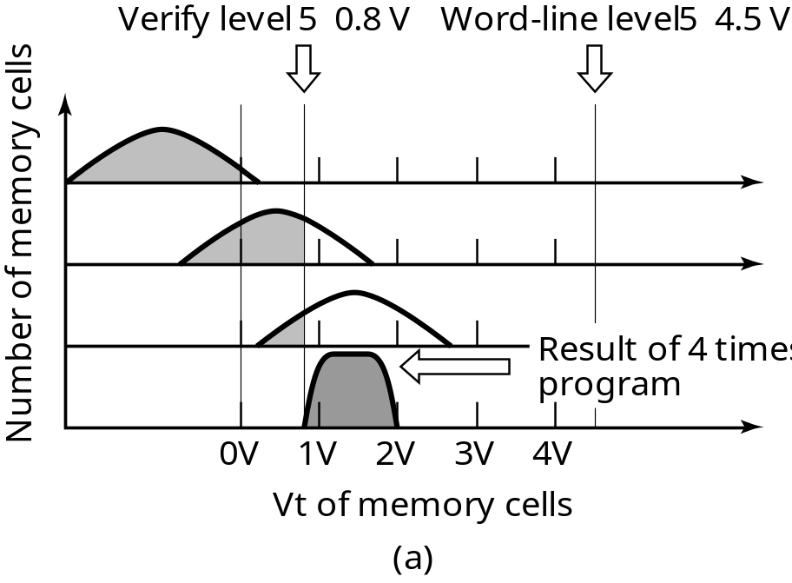
Writing Flash Memory
10
8
10
6
10
4
10
2
10
0
Read level (4.5 V)
0V
1V
2V
3V
4V
Number of cells
Vt of memory cells
Evolution of thresholds
Final Distribution
From [Nakamura02]

Slide 102
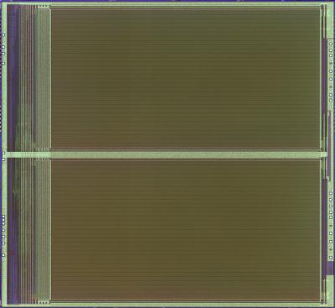
125mm² 1Gbit NAND Flash Memory
32 word lines
x 1024 blocks
10.7mm
Charge pump
2kB Page buffer & cache
16896 bit lines
11.7mm
From [Nakamura02]

Slide 103
125mm² 1Gbit NAND Flash Memory
Technology 0.13μm p-sub CMOS triple-well
1poly, 1polycide, 1W, 2Al
Cell size 0.077μm2
Chip size 125.2mm2
Organization 2112 x 8b x 64 page x 1k block
Power supply 2.7V-3.6V
Cycle time 50ns
Read time 25μs
Program time 200μs / page
Erase time 2ms / block
From [Nakamura02]

Slide 104
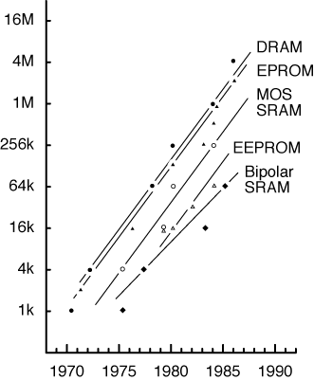
Semiconductor Memory Trends
(up to the 90’s)
Memory Size as a function of time: x 4 every three years

Slide 105
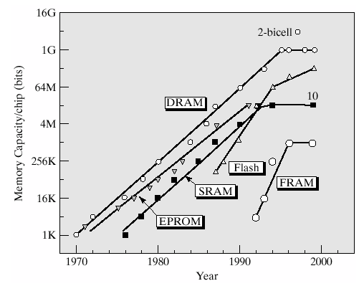
Semiconductor Memory Trends
(updated)
From [Itoh01]

Slide 106
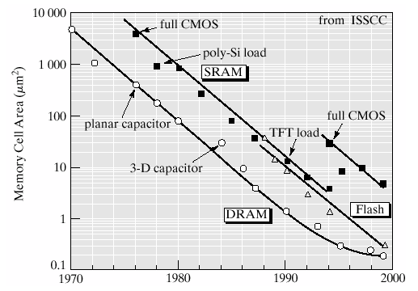
Trends in Memory Cell Area
From [Itoh01]

Slide 107
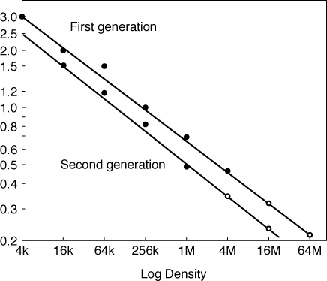
Semiconductor Memory Trends
Technology feature size for different SRAM generations

